Slide 1
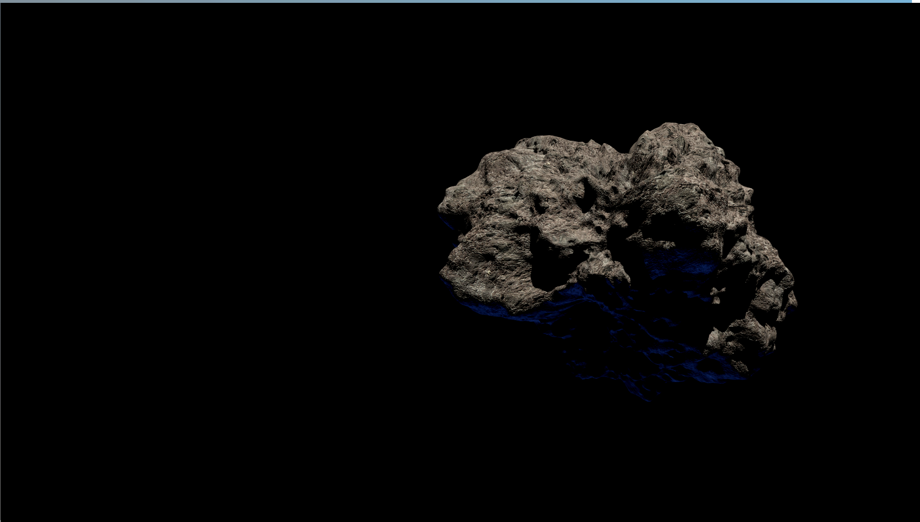
METEORITE
MINERAL
MAPPING

Slide 2
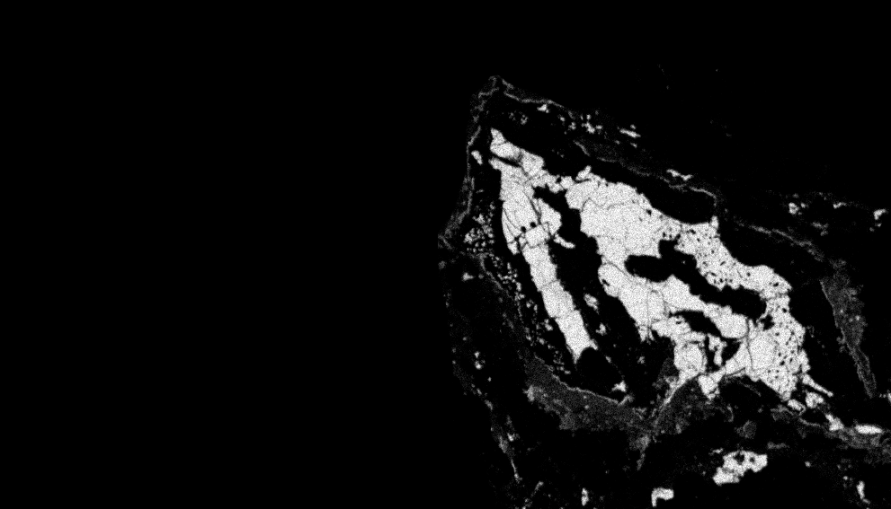
PROBLEM STATEMENT

Slide 3
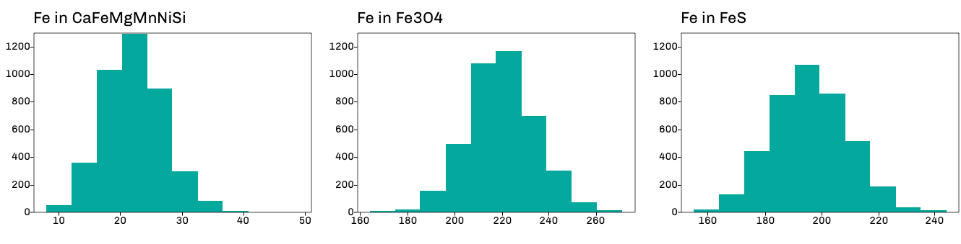
STANDARD MINERALS
Fe distribution in standards

Slide 4
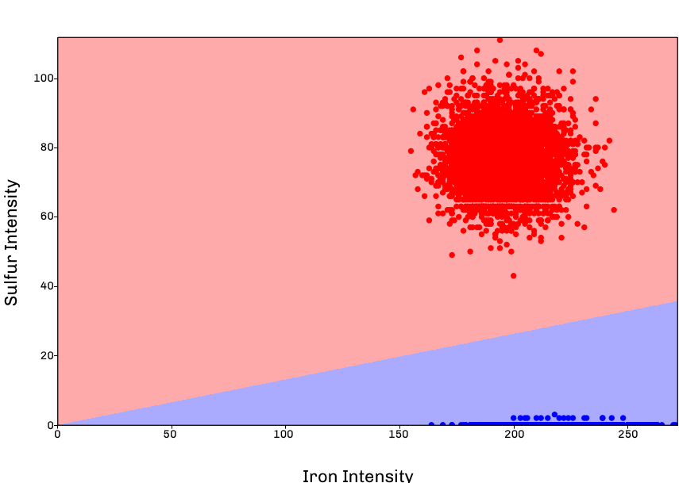
CLASSIFICATION OF STANDARDS
FeS (red) vs Fe3O4 (blue)

Slide 5
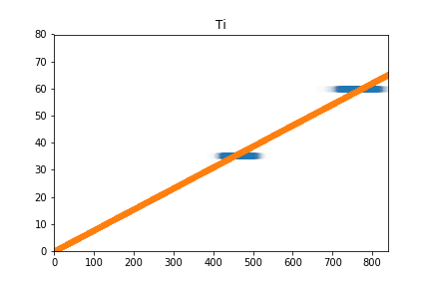
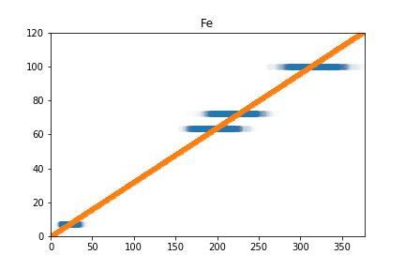
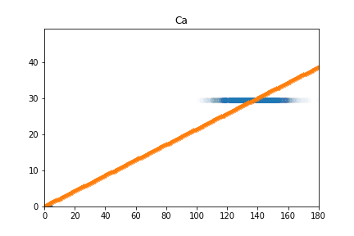
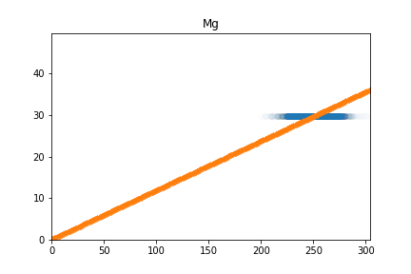
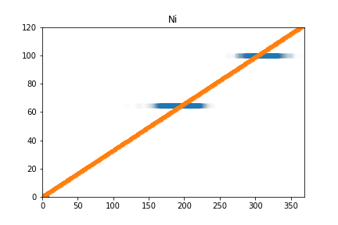
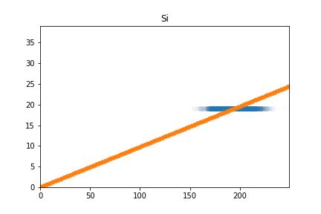
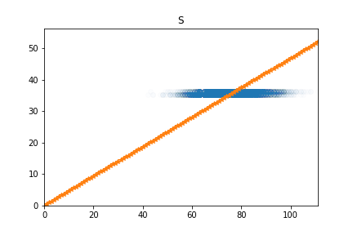
WEIGHT/INTENSITY REGRESSION
Regressions are used to interpolate intensities in unknown minerals

Slide 6
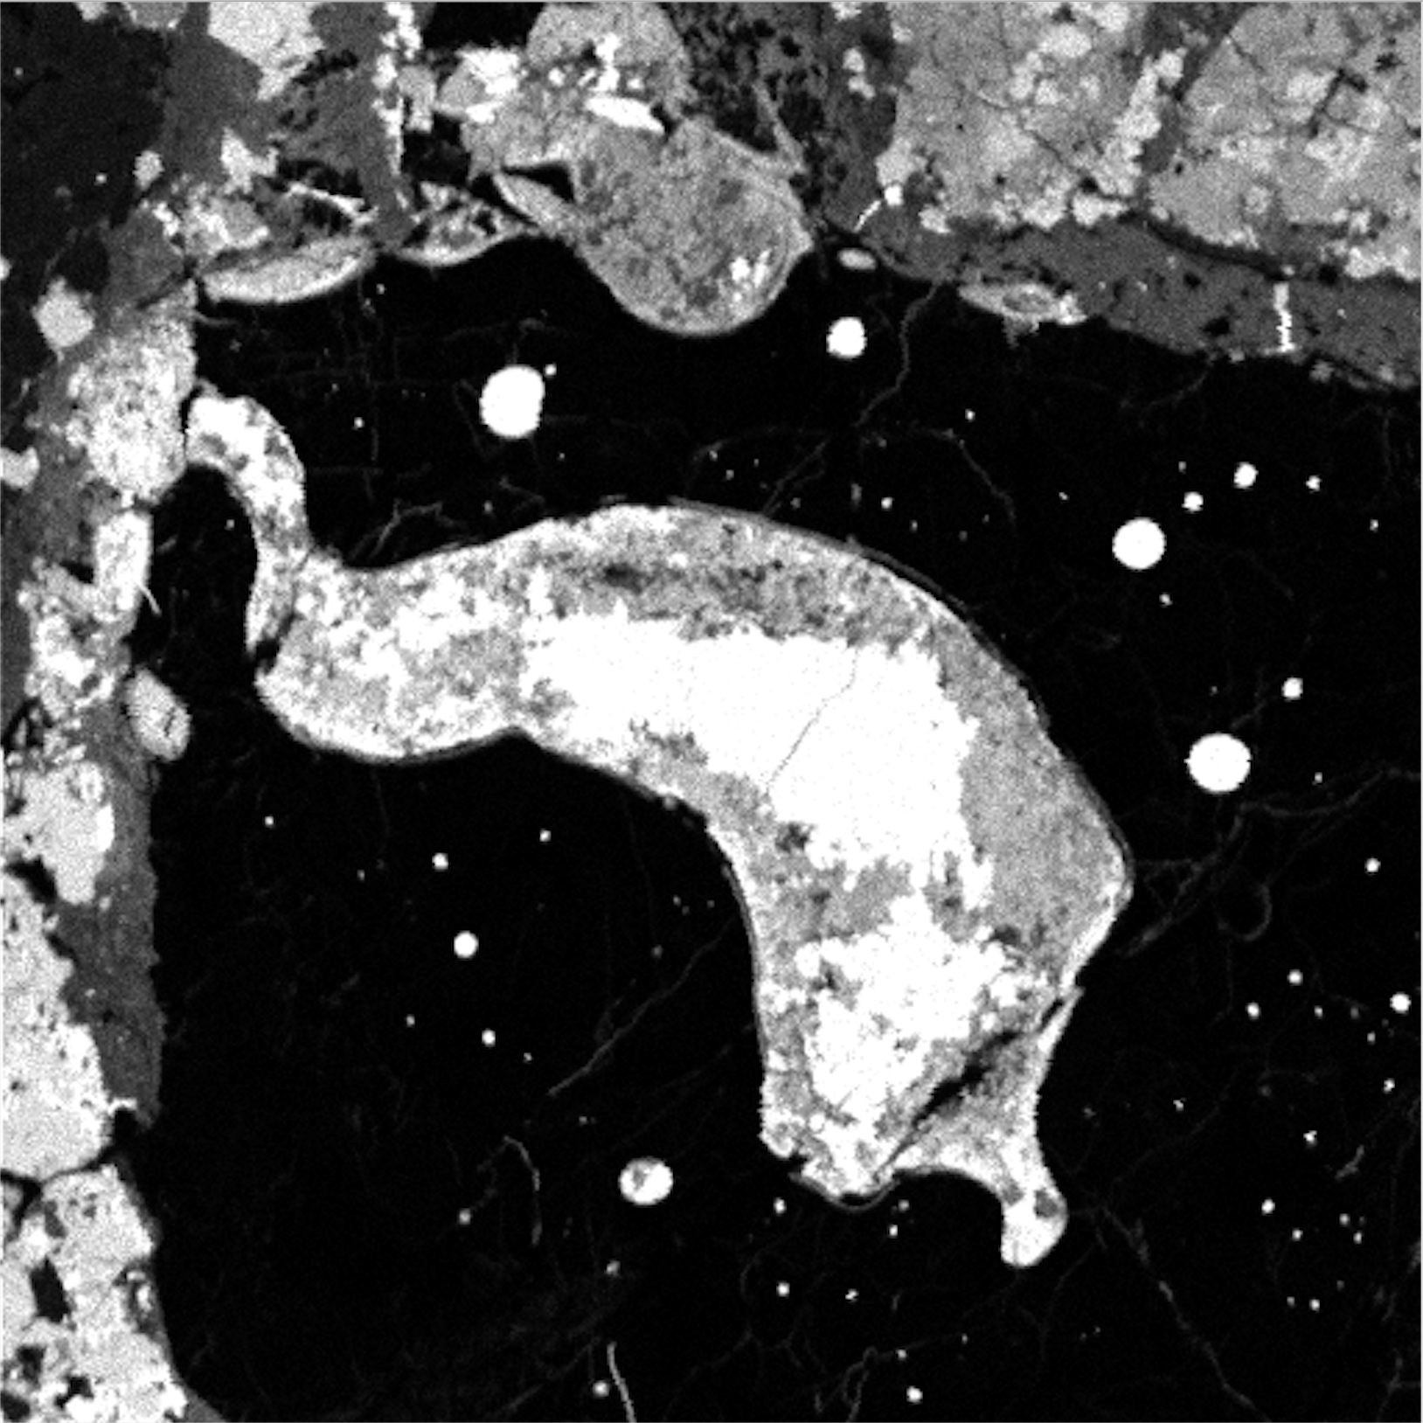
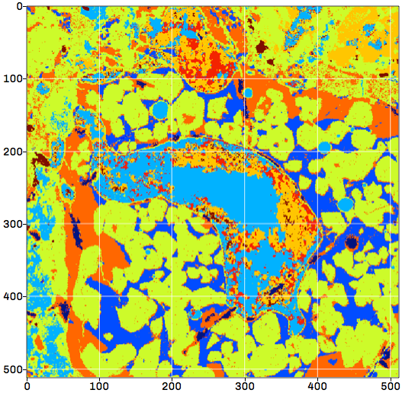
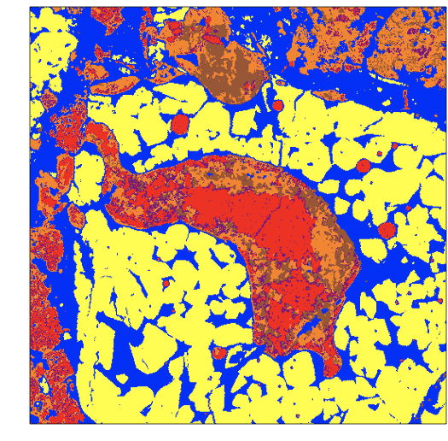
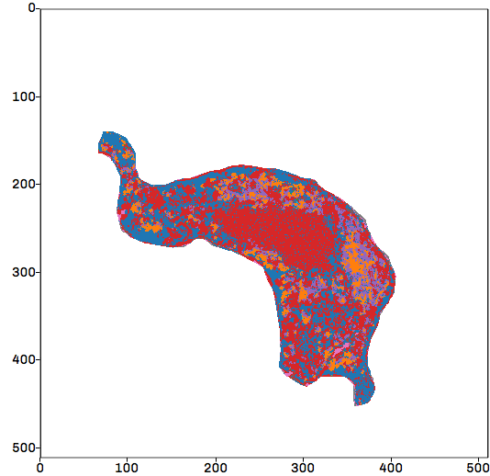
METEORITE 1
OBJECT 1 MINERAL PREDICTION
RANDOM FOREST
NEAREST-NEIGHBOR CLASSIFIER
DBSCAN

Slide 7
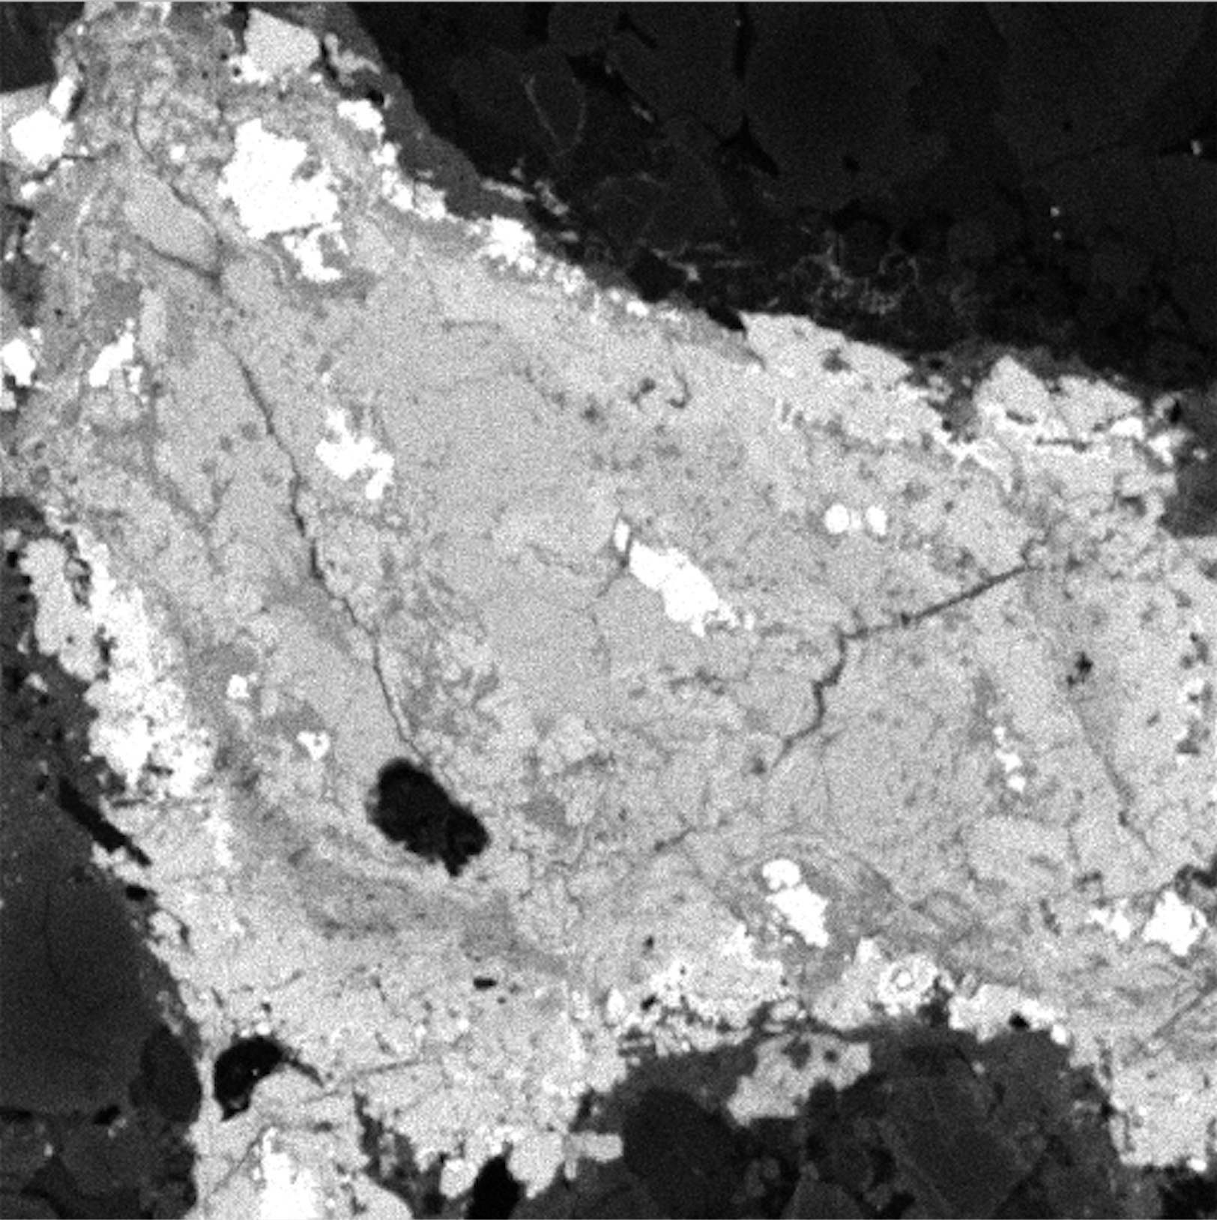
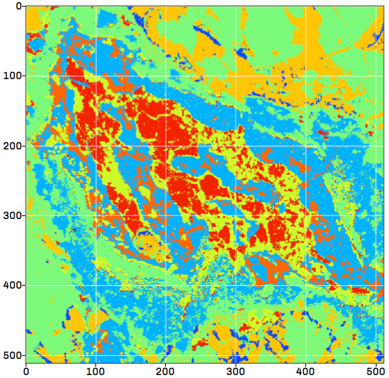
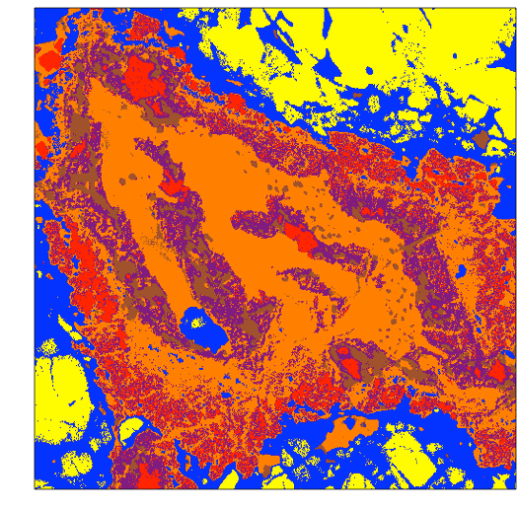
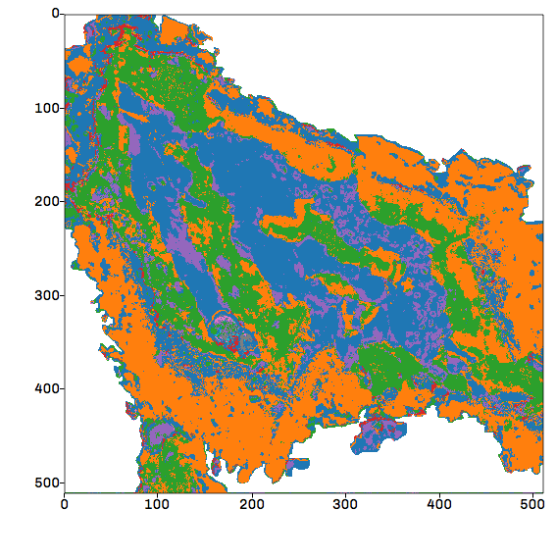
METEORITE 2
OBJECT 2 MINERAL PREDICTION
RANDOM FOREST
NEAREST-NEIGHBOR CLASSIFIER
DBSCAN

Slide 8
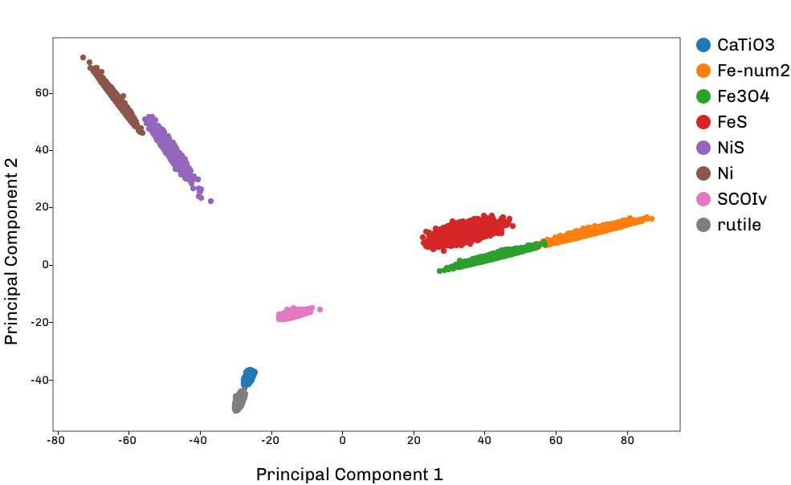
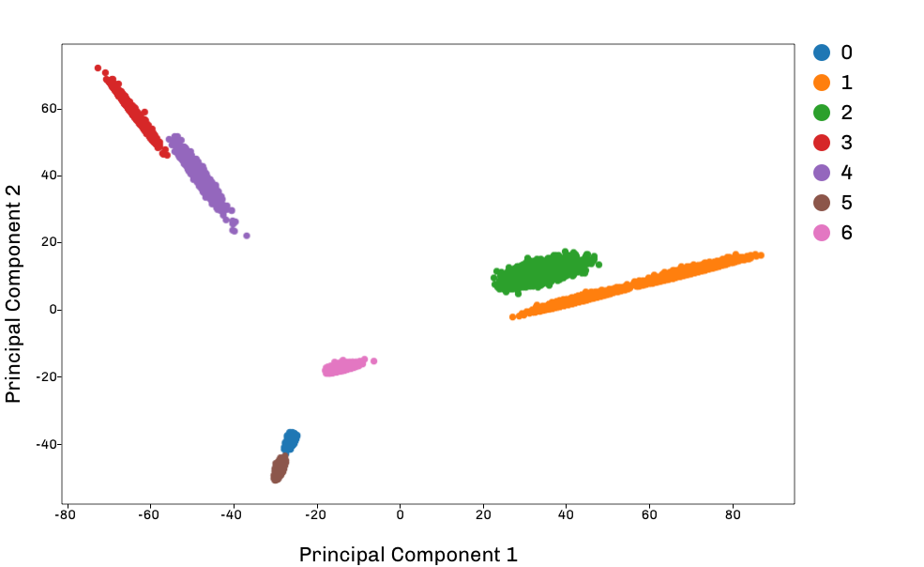
CLUSTER IDENTIFICATION
MINERAL CLUSTERING
PREDICTED CLUSTERING
DBSCAN clustering was used to identify clusters in intensity data

Slide 9
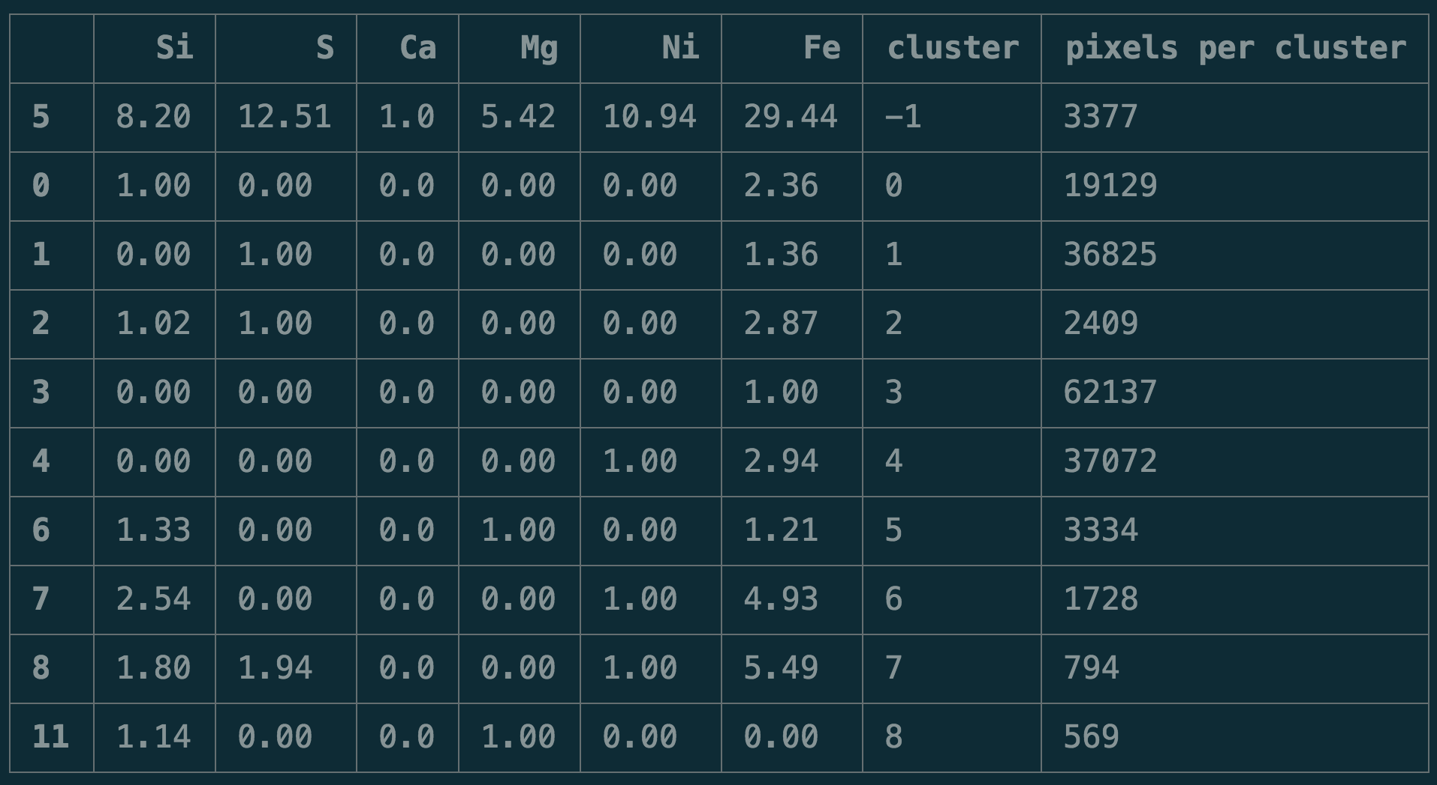
CORRELATING CLUSTERS

Slide 10
TAKEAWAYS

